Slide 1

Addressing Healthcare Workforce Shortages
Final Project WIP
HCIP 6396
https://www.aha.org/aha-center-health-innovation-market-scan/2022-06-28-how-some-hospitals-are-grappling-workforce
Reet Verma | Jayashree Kanukollu

Slide 2

Background of Business Problem
Covid has exposed healthcare workforce shortages
“History of shortages in filling residency positions” in certain fields (Alam 2022)
Rural and underserved areas have been unequally impacted by labor shortages
High turnover rates in certain roles
Current programs to address shortages have not been effective
  Should be “targeted within healthcare landscape” (Alam 2022)
https://www.nature.com/articles/s41591-023-02698-6
Notes:
Jayashree
An analysis of the Labor Market and Analytics and Economic Data indicated a future shortage of close to 3.5 million healthcare workers by 2026 (Association of American Medical Colleges 2021).
Additionally, there has been a history of shortages in filling residency positions for primary care physicians, pathologists, neurologists, and psychiatrists
In rural and underserved areas, there is a greater shortage of those in the healthcare workforce and providing workforce development programs is a step to alleviate these shortages. Only 9% of the physician workforce works in a rural area currently, further escalating the healthcare problems that occur in rural areas. People living in rural areas are also less likely to be insured, have encompassing benefits, and be able to access care
Furthermore, as shortages are occurring, the healthcare industry and policy makers are actively seeking ways to reform and improve the delivery system, including the development of new payment policies and incentives to reward improved performance in an area (Salsberg 2015
High turnover rates in fields like direct support because of lack of reimbursement
Current programs to address shortages: tax incentives for apprenticeships such as shadowing opportunities for high schoolers, lack of government sponsored health care insurance plans in rural areas (more likely to be uninsured or have fewer benefits)
How can retention and recruitment strategies be developed to address workforce shortages? (potential answer- focus on areas of most need, whether that is by state, by sector, or by profession)

Slide 3
Why is BI Relevant?
Business Intelligence helps us turn huge, complex healthcare datasets into clear and meaningful visuals
It gives decision-makers a way to see where the shortages are most critical—by state, by profession, or by community
Using BI, healthcare leaders can make smarter choices about where to focus recruitment and funding efforts
It helps track how well workforce programs and incentives are working over time
Most importantly, BI connects the data to real people—helping us match the healthcare workforce to the needs of growing and underserved populations
Notes:
Jayashree
How can retention and recruitment strategies be developed to address workforce shortages? (potential answer- focus on areas of most need, whether that is by state, by sector, or by profession)

Slide 4

Data Summary
Data Source: Health Resources & Services Administration (HRSA) Data Warehouse
Dataset covers: Health Professional Shortage Areas (HPSA) across U.S. states and counties
Focus: North Carolina — filtered from 19,000 + national records to 567 active designations
Fields used: State, County/Facility, HPSA Discipline Class, HPSA Score, Designation Type
Key KPIs:
  Average HPSA Score per State
  Average HPSA Score per Discipline (Mental Health, Primary Care)
  Number of Shortage Designations per County
Notes:
Jayashree

Slide 5
HPSA Designation and Scores
HPSA Designation: Health Provider Shortage Areas, identified by HRSA
  Can be “geographic areas, populations or facilities with shortage of primary, dental or mental health care providers” (HRSA)
  Designation is used by National Health Service Corp for distribution of participants
“HPSA Score Calculation: based on 3 categories
Population to provider ratio
Percent of population below 100% of Federal Poverty Level
Travel time to nearest source of care outside of designation area” (HRSA)
Notes:
Jayashree
National health service corp: scholarship for students pursuing certain areas of study such as primary care

Slide 6
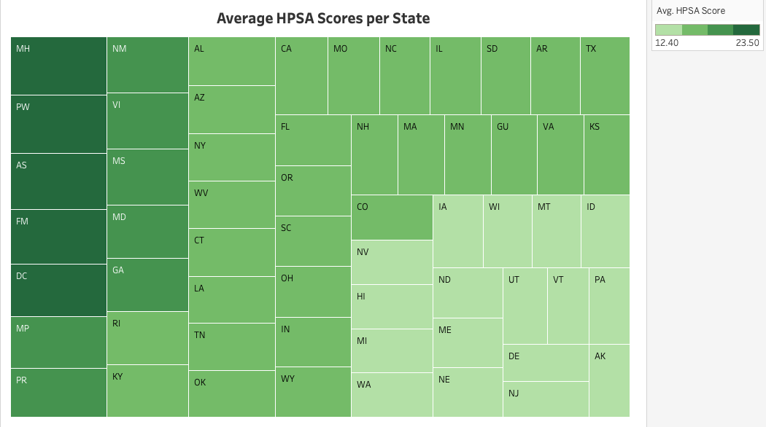
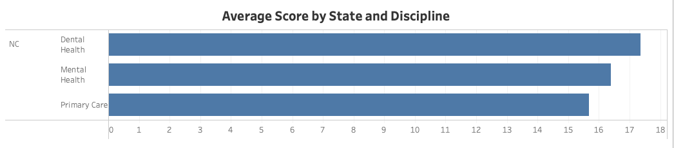
Overview of Visualization Solutions
Overall objectives: highlight areas that are in most need of targeted approaches, especially in North Carolina, and incorporate intractability
  By geography: maps of US/ NC and heatmaps per state showing HPSA scores
  By discipline: bar graph
  By population: filled map showing select counties (North Carolina Counties by Population(2024))
Notes:
Both
Reet: Main point of visualizations: addressing workforce shortages in health care requires targeted approaches that take into account the healthcare landscape of a specific location, because it is evident that workforce shortages are more exacerbated in some areas than others- such as rural areas and health care deserts. Because of this, we decided to visualize the KPIs in relation to state, discipline, and county. Thus, we decided to create geographic filled maps, heat maps, and bar graphs to visualize this.

Slide 7
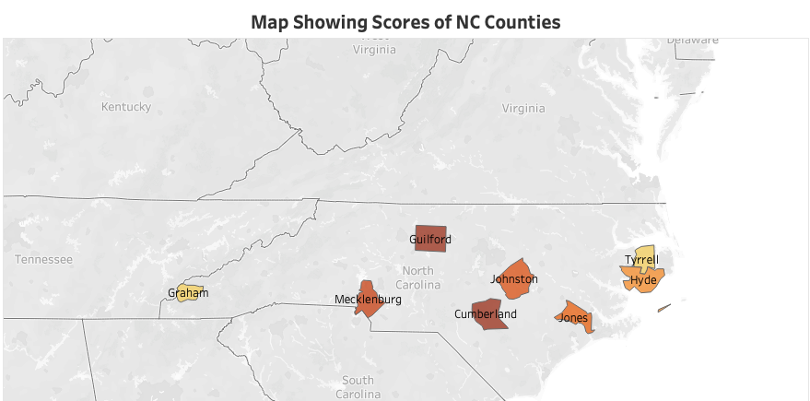
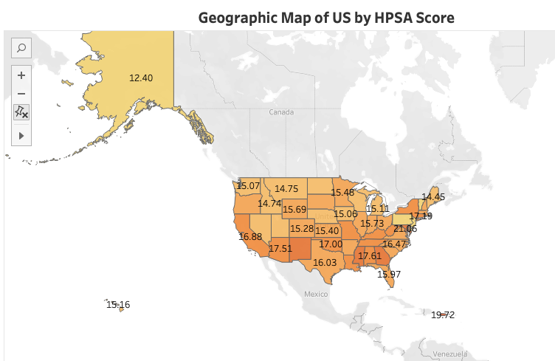
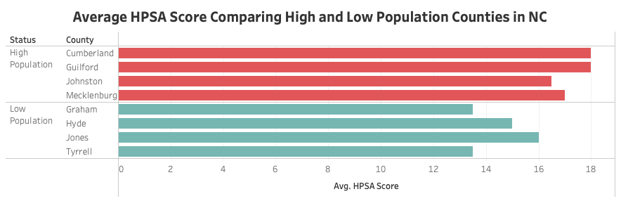
Overview of Visualization Cont.
Notes:
Both
Reet:

Slide 8
Evolution of Dashboard
1
Selecting KPIs and parts of data for use
2
Data cleaning and subsetting
3
Creation of visualizations
4
Creation of initial dashboard prototype
5
Addition of interactive features leading to final prototype
Notes:
Reet
Evolution of the dashboard started with selection of KPIs and parts of data from the HRSA data warehouse to use, given that this was such a large dataset. Next, the data was cleaned within Tableau to remove NA columns. In order to use county level data within the state of north carolina, the data set had to be subsetted given that some counties were listed with different identifiers, such as middle income and lower income, which made it difficult for Tableau to recognize these as geographic locations. This was done by researching counties in NC with highest and lowest population levels, in order to visualize whether there was a relationship between population levels and hpsa scores. After this data was selected, the visualizations were created and added onto the initial dashboard prototype. The layout was changed by adding national data at the top of the dashboard, and state/ county data towards the bottom to assist in storytelling. Lastly, interactive features were added to the dashboard by adding a filter for the bar graph so that viewers can choose which state data to see scoring for per discipline.

Slide 9
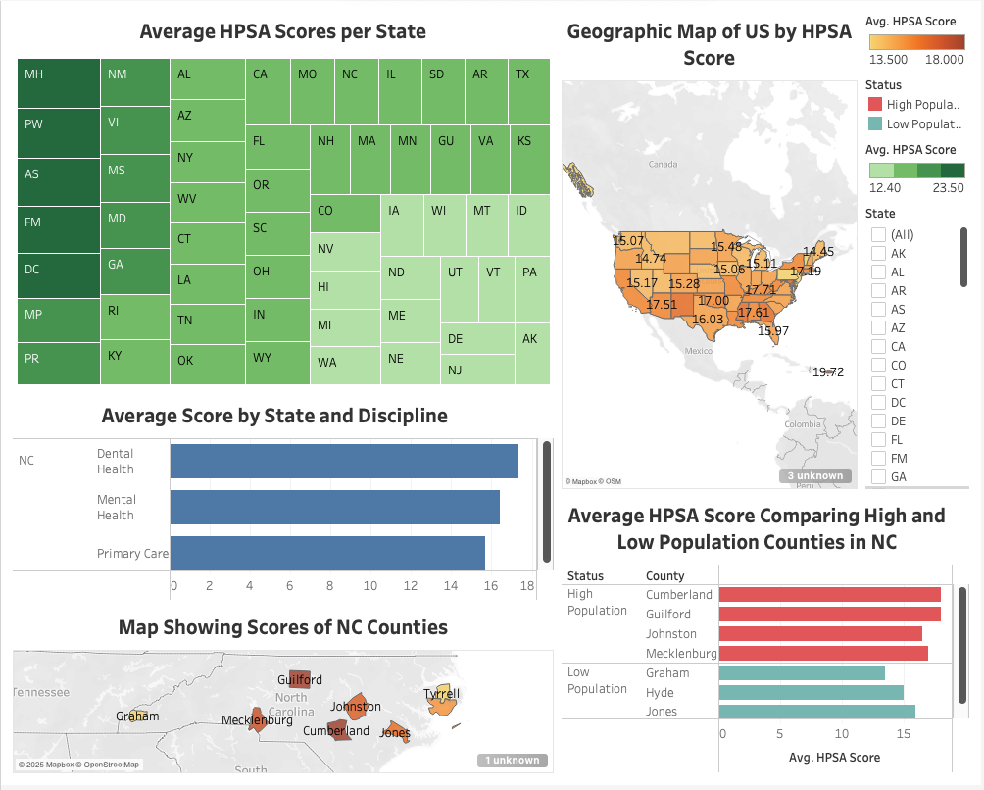
Demo
Notes:
Reet

Slide 10
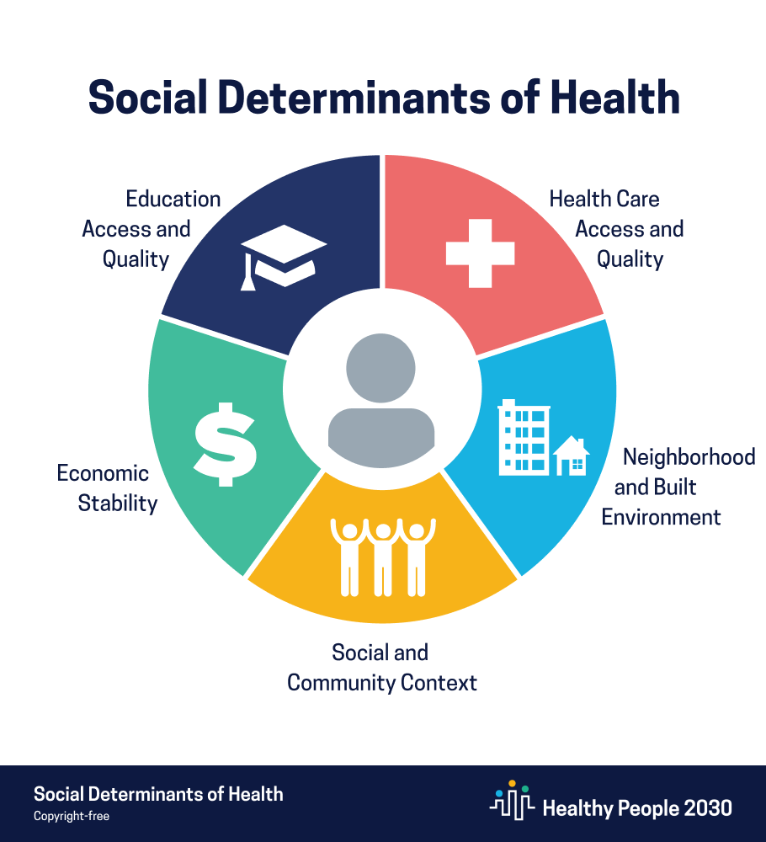
Limitations
Missing data/ overlapping designations for some counties
  Resulting in bias when analyzing county data based on population
Data types
  Had to create subsets of data in order for Tableau to recognize geographic location
Amount of data
  Large dataset hard to parse through
Scoring metrics
  HPSA scoring does not account for other factors limiting access to care like insurance coverage or Social Determinants of Health
https://www.lifecarealliance.org/what-you-should-know-about-social-determinants-of-health/
Notes:
Reet
We encountered many limitations in this project that ultimately affected creation of visualizations for the dashboard. One of them included missing data for some counties- which may be due to the designation status of the health professional shortage areas. Due to this, when choosing county data to include, some bias may have been introduced. Additionally, conflicting data types lead us to subsetting the data in order to create our geographic maps. The data warehouse also contained a large amount of data, which was hard to parse through. The scoring metrics used by Health Resources and Services administration also had some limitations- for example, the calculation of HPSA scores did not account a variety of factors which may influence access to health care such as insurance coverage or other social determinants of health.

Slide 11

Conclusion
BI is a powerful tool that can help drive policy/ program recommendations and changes to alleviate burden of workforce shortages in healthcare
  Efforts can be “targeted within the healthcare landscape” (Alam 2022)
  Example: creating more pipeline programs for rural students to practice in rural areas (Alam 2022)
HPSA designation and scoring is useful but should be updated to include more factors that impact healthcare delivery
https://www.ache.org/blog/2024/lets-flip-the-question-of-the-healthcare-workforce-shortage
Notes:
Reet
In conclusion, this project showed us that BI is a powerful tool that can help drive policy and program recommendations and changes to alleviate burden of workforce shortages in health care. Research shows that in order to combat this issue, efforts should be targeted within the healthcare landscape- so bi solutions should be focused around this. Examples of these kinds of solutions would include creating more pipeline programs for rural students to practice in rural areas, awarding scholarships to students pursuing certain fields of study such as primary care, or creating a centralized department of workforce development within each state and programs with direct career opportunities. While the HRSA data warehouse was a valuable tool to highlight where these efforts may be most needed, designation and scoring should be updated to include more factors that impact healthcare delivery.
Another example: awarding scholarships to students pursuing certain fields of study such as primary care, increase funding for rural areas, creating centralized department of workforce development office within each state and programs with direct career opportunities

Slide 12
Works Cited
Alam, F. (2022). Addressing Workforce Shortages Through Equitable Design of Education and Opportunities. Journal of Science Policy & Governance, 20(02). https://doi.org/10.38126/jspg200201
Data Explorer. (2025). Hrsa.gov. https://data.hrsa.gov/data/data-explorer
North Carolina Counties by Population (2024). (2024). Worldpopulationreview.com. https://worldpopulationreview.com/us-counties/north-carolina
Scoring Shortage Designations | Bureau of Health Workforce. (n.d.). Bhw.hrsa.gov. https://bhw.hrsa.gov/workforce-shortage-areas/shortage-designation/scoring

Slide 13
THANK YOU

